Slide 1


Slide 2

The Challenge
How might we?
Motivate today‘s youth (17 – 23)
to live more healthy and active lives?​
Aims
Encourage youth to try new sports and improve
the availabilty and accessabilty of activities. ​
Desired outcomes
Healthier Society, reduced possibilty of obesity,
increased interactions and social networking.

Slide 3
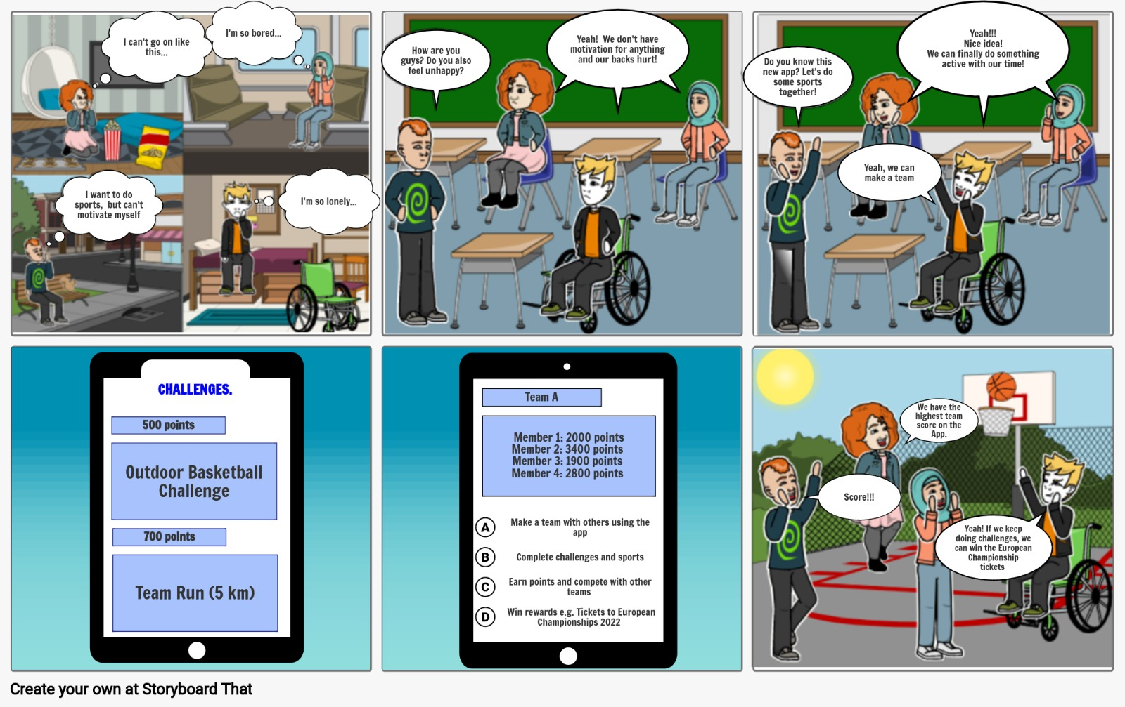
Our Story

Slide 4
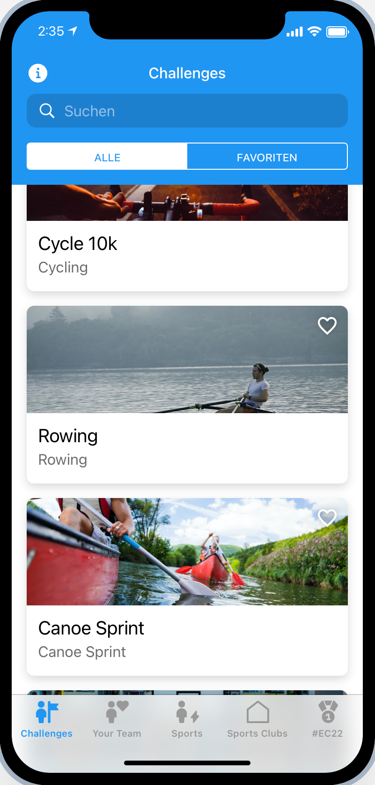

Our Idea
SOCIAL NETWORK
EARN REWARDS
as a sports app
After completing challenges
VARIOUS CHALLENGES
COMPETITION WITH
OTHER TEAMS
and sports for target market to try​
can motivate and inspire participants in the long term​
WORK WITH LOCAL
SPORTS CLUBS

Slide 5
LIVE DEMO
https://exclusive-slip-1184.glideapp.io

Slide 6
Customers
B2C
B2B
Local sports clubs
Young generation (age 17-23)
Sports events
Sports goods brands
Connecting by establishing a network of sports enthusiasts Involving sports clubs & events by Co-Creating Challenges

Slide 7
Partners
Challenge sponsors
General sponsors
European Championships 2022
Sports goods / accessories brands
Local sports clubs
Expanding visiter / member base
Target specific audience for advertisment, connecting with young market segment

Slide 8
Activities & Resources
App Development & Maintenance
Marketing & Customer acquisition
External App Development
Internal Operations & Maintenance
→ DevOps Engineer
B2C
B2B
(Social Media) Marketing
→ Marketing specialist
Partner Management
→ Sales representative

Slide 9
Costs & Revenue
Initial Costs
External App Development (ca. $50.000)
Market Introduction (e.g. initial advertisment at / for European Championships)
Operational Costs
Server and App Maintenance
(Social Media) Marketing
B2B Customer aquisition
Revenue
Ads (e.g. sports goods brands)
Sponsoring (e.g. challenge givers)

Slide 10
Our Challenge Contribution
“
How can the the European Championships Munich 2022 motivate their visitors and spectactors to do more sports and inspire them to lead more active lifestyles, creating a positive impact for local sport clubs and society as a whole?
”
For customers
For local sports clubs
For the European Championships

Slide 11
Our Experience
@ GXC
@ Coaching
@ Virtual Course format

Slide 12
THANK YOU!

